Slide 1
The contemporary issues in Management and OB

Slide 2
Knowledge Management
Knowledge creation
Knowledge gathering
Knowledge storage
Knowledge retrieval
Knowledge sharing
Knowledge dissemination
Knowledge application

Slide 3
MCQ
Expertise and experience of organizational members that has not been formally documented is known as:
A. knowledge sharing
B. tacit knowledge
C. organizational learning
D. organizational memory

Slide 4
Reverse mentoring
Reverse mentoring is simply the opposite format of traditional mentoring, where the senior leader is mentored by a younger or more junior employee.
The process recognizes that there are skills gaps and opportunities to learn on both sides of a mentoring relationship, and flipping the traditional format on its head can be very beneficial for both parties.

Slide 5
Attributes of successful mentors
Honesty
Reliability
Caring
Sharing
Giving
Patience
Strong interpersonal skills

Slide 6
Glossary
Mentor a person who sponsors or supports another person to achieve a goal.
Mentee is the one who is mentored.
Mentoring is a process, where a person volunteers to assist another with their learning and general development.
A mentor is an experienced adviser or colleague, supervisor or trainer/instructor who adopts a shared and integral role in the learning process.

Slide 7
Benefits of reverse mentoring
Building a learning culture
Closing generational gaps
Developing leadership skills in younger employees
Millennial retention
Sharing different perspectives
Developing communication skills
Developing self-confidence and self-awareness

Slide 8
How to set up a reverse mentoring program
Step 1: Outline the objective
Step 2: Design the reverse mentoring program
Step 3: Recruit mentors and mentees
Step 4: Matching Mentors and Mentees
Step 5: Launch and monitor the reverse mentoring program.

Slide 9
MCQ
Millennial retention is one of the objectives of –
A. Talent management
B. Reverse mentoring
C. Workforce diversity
D. None of the above

Slide 10


Talent Management

Slide 11
What is Talent?
According to McKinsey; talent is the sum of
a person’s abilities,
skills, knowledge, experience ,
intelligence,
judgment, attitude, character, drive,
his or her ability to learn and grow.

Slide 12
Talent Management
Talent Management is a set of integrated organizational HR processes designed to attract, develop, motivate, and retain productive, engaged employees.
The goal of talent management is to create a high-performance, sustainable organization that meets its strategic and operational goals and objectives.

Slide 13
Process

Slide 14
Need of Talent Management
Talent Management" has become one of the most important buzzwords in Corporate HR and training today.
Organizations know that they must have the best talent in order to succeed in the hypercompetitive and increasingly complex global economy.
They must manage talent as a critical resource to achieve the best possible results in the long run.

Slide 15
Benefits of Talent Management
Right Person in the right Job
Retaining the top talent
Understanding Employees
Better professional development decisions
http://www.managementstudyguide.com/benefits-of-talent-management.htm

Slide 16

In 1980 older companies like PepsiCo and GE that invested in development became well known as “academy companies” in today’s time.

Slide 17
MCQ
Talent Management is a _________________ Process A. Constant Process B. One time process C. Retrospective Process D. None of the above

Slide 18
MCQ
Talent Management process ends with which of the following A. Strategy for retention B. Hold performance appraisal C. Plan for succession D. Specify what skills you need

Slide 19

Workforce Diversity

Slide 20
Workforce Diversity
Workforce diversity means the heterogeneous composition of employees of an organization in terms of age, gender, language, education, marital status, etc.
Managing such diversity is really a challenge to HRM professionals.

Slide 21
Reasons for Growing Interest in Workforce Diversity
Globalization of Markets
Mergers and Strategic Alliances
Increasing Role of Work Teams
Changing labor market
Changing Composition of Workforce
Legal Requirements

Slide 22
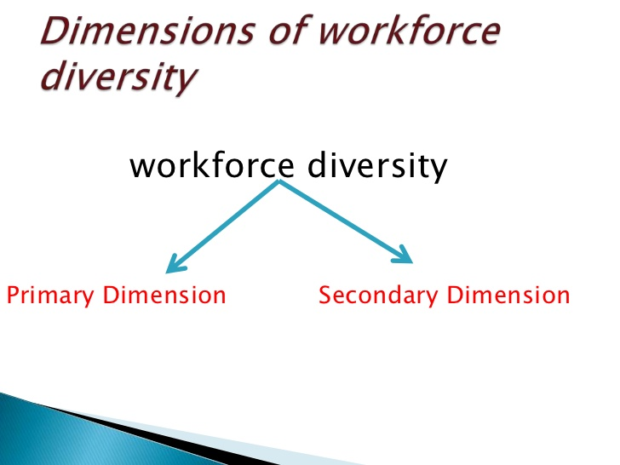

Slide 23
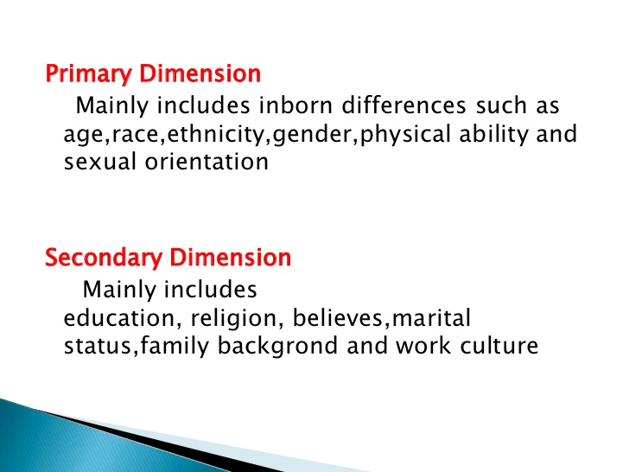

Slide 24
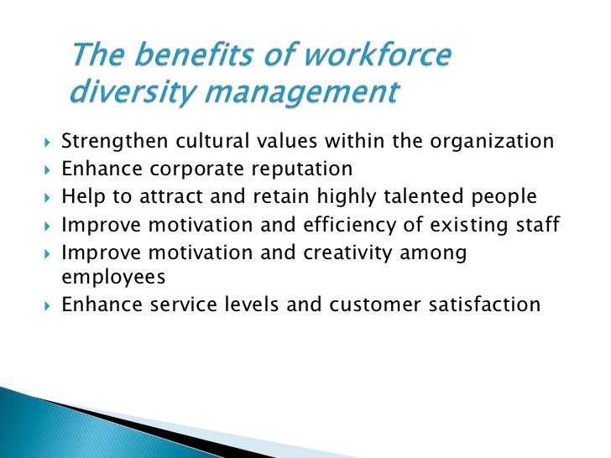
Benefits of workforce diversity

Slide 25
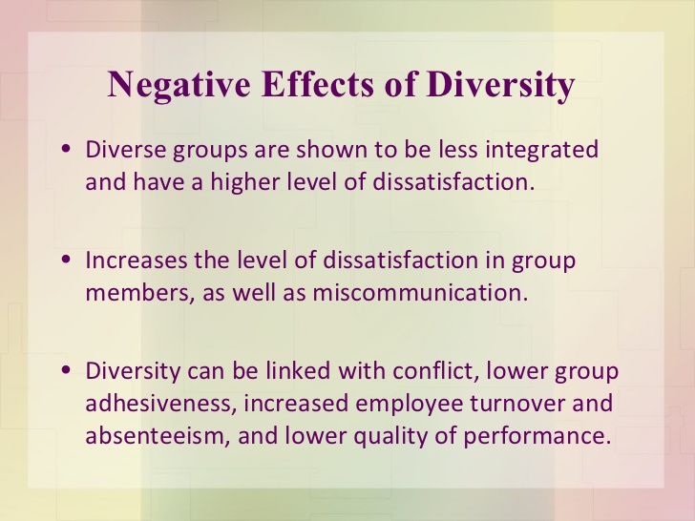

Slide 26
Management of workforce diversity
Ensuring Top Management Commitment to Value Diversity
Reviewing Hiring and Promotion Policies
Organizing Diversity Training Program
Forming a Support Group
Communicating through an Appropriate Language
Establishing Diversity Monitoring System

Slide 27
Reverse mentoring
Reverse mentoring is simply the opposite format of traditional mentoring, where the senior leader is mentored by a younger or more junior employee.
The process recognizes that there are skills gaps and opportunities to learn on both sides of a mentoring relationship, and flipping the traditional format on its head can be very beneficial for both parties.

Slide 28
Attributes of successful mentors
Honesty
Reliability
Caring
Sharing
Giving
Patience
Strong interpersonal skills

Slide 29
Glossary
Mentor a person who sponsors or supports another person to achieve a goal.
Mentee is the one who is mentored.
Mentoring is a process, where a person volunteers to assist another with their learning and general development.
A mentor is an experienced adviser or colleague, supervisor or trainer/instructor who adopts a shared and integral role in the learning process.

Slide 30
Benefits of reverse mentoring
Building a learning culture
Closing generational gaps
Developing leadership skills in younger employees
Millennial retention
Sharing different perspectives
Developing communication skills
Developing self-confidence and self-awareness

Slide 31
How to set up a reverse mentoring program
Step 1: Outline the objective
Step 2: Design the reverse mentoring program
Step 3: Recruit mentors and mentees
Step 4: Matching Mentors and Mentees
Step 5: Launch and monitor the reverse mentoring program.

Slide 32
MCQ
Millennial retention is one of the objectives of –
A. Talent management
B. Reverse mentoring
C. Workforce diversity
D. None of the above

Slide 33
Labor Law Reforms in India
29 existing labor laws replaced with four Codes. The objective is to simplify and modernize labor regulation.
THE CODE ON SOCIAL SECURITY, 2020
THE INDUSTRIAL RELATIONSCODE, 2020
THE OCCUPATIONAL SAFETY, HEALTH AND WORKING CONDITIONS CODE, 2020
THE CODE ON WAGES, 2019

Slide 34
THE CODE ON SOCIAL SECURITY, 2020
Employees insurance
Provident Fund
Gratuity
Maternity benefits
Employees Compensation

Slide 35
THE INDUSTRIAL RELATIONSCODE, 2020
TRADE UNIONS
MECHANISM FOR RESOLUTION OF INDUSTRIAL DISPUTES
STRIKES AND LOCK-OUTS
LAY-OFF, RETRENCHMENT AND CLOSURE

Slide 36
THE OCCUPATIONAL SAFETY, HEALTH AND WORKING CONDITIONS CODE, 2020
OCCUPATIONAL SAFETY AND HEALTH
DUTIES OF EMPLOYER AND AMPLOYEES, ETC.
WORKING CONDITIONS
WELFARE PROVISIONS
HOURS OF WORK AND ANNUAL LEAVE WITH WAGES

Slide 37
…………
MAINTENANCE OF REGISTERS, RECORDS AND RETURNS
INSPECTOR-CUM-FACILITATORS AND OTHER AUTHORITY
SPECIAL PROVISION RELATING TO EMPLOYMENT OF WOMEN
SPECIAL PROVISIONS FOR CONTRACT LABOUR AND INTER-STATE MIGRANT WORKER, ETC.
https://www.youtube.com/watch?v=YEkHQ3kepXI

Slide 38
THE CODE ON WAGES, 2019
MINIMUM WAGES
WAGES FOR OVERTIME WORK
PAYMENT OF BONUS
PAYMENT OF DUES AND CLAIMS
INSPECTOR-CUM-FACILITATOR

Slide 39
Overview of Labor Law Reforms
Coverage: Most labor laws apply to establishments over a certain size (typically 10 or above).
Retrenchment: Establishments hiring 100 or more workers need government permission for closure, layoffs or retrenchments.
Labor enforcement: Multiplicity of labor laws has resulted in distinct compliances, increasing the compliance burden on firms and this is addressed by the reforms.

Slide 40
………
Trade Unions: There are several registered trade unions but no criteria to ‘recognize’ unions which can formally negotiate with employers.
The Industrial Relations Code creates provisions for recognition of unions.

Slide 41
Health, Safety and Welfare provisions under Factories Act 1948
Expected learning outcome-
to understand Health, Safety and Welfare provisions under Factories Act 1948

Slide 42
Health, Safety and Welfare provisions under Factories Act 1948
There are various measures under Factories Act 1948 which are taken by factories for health, safety and welfare of their workers.
Such measures are provided under Chapters III, IV and V of the Act which are as follows:

Slide 43
HEALTH
(i) Section 11 ensures the cleanliness in the factory
All the accumulated dirt and refuse on floors, staircases and passages in the factory shall be removed daily
Once in every week, the floor should be thoroughly cleaned by washing with disinfectant
Effective method of drainage shall be made and maintained for removing water
All doors, windows and other framework which are of wooden or metallic shall be kept painted or varnished at least once in every period of five years
The dates on which such processes are carried out shall be entered in the prescribed register.

Slide 44
……….
(ii) Disposal of waste
Every occupier of a factory shall make effective arrangements for the treatment of wastes and effluents due to the manufacturing process carried on in the factory so as to render them innocuous and for their disposal

Slide 45
……..
(iii) Ventilation and temperature Section 13 provides that every factory should make suitable and effective provisions for securing and maintaining :
adequate ventilation by the circulation of fresh air; and
such a temperature as will secure to the workers reasonable conditions of comfort and prevent injury to health

Slide 46
………..
(iv) Dust and fume
Effective measures should be taken to prevent the inhalation and accumulation of dust, fumes etc., in the work-rooms.
Wherever necessary, an exhaust appliances should be fitted, as far as possible, to the point of origin of dust fumes or other impurities

Slide 47
…………..
(v) Artificial humidification Humidity means the presence of moisture in the air. In certain industries like cotton, textile, cigarette, etc., higher degree of humidity is required for carrying out the manufacturing process.
For this purpose, humidity of the air is artificially increased which affects the health of the worker.

Slide 48
…………..
Section 15(1) empowers the State Government to make rules (i) prescribing the standards of humidification, (ii) regulating methods to be adopted.
Section 15(2) lays down that water used for artificial humidification should be either purified before use or obtained from a public supply or other source of drinking water.

Slide 49
………….
(vi) Overcrowding Overcrowding in the work-room not only affect the workers in their efficient discharge of duties but their health also.
Section 16 has been enacted with a view to provide sufficient air space to the workers.
(1) Section 16(1) prohibits the overcrowding

Slide 50
……….
(vii) Lighting Section 17 of the Factories Act makes following provisions in this respect:
every factory must provide and maintain sufficient and suitable lighting, natural, artificial or both, in every part of the factory where workers are working or passing;

Slide 51
…………
(viii) Drinking water Section 18 makes following provisions with regard to drinking water.
every factory should make effective arrangements for sufficient supply of drinking water for all workers in the factory;
water should be wholesome, i.e., free from impurities
water should be supplied at suitable points convenient.

Slide 52
Safety
(i) Fencing of machinery
Fencing of machinery in use or in motion is obligatory under Section 21.

Slide 53
……….
(ii) Safety measures in case of work on or near machinery in motion No woman or young person shall be allowed to clean, lubricate or adjust any part of a prime-mover or any transmission machinery while the prime-mover or transmission machinery is in motion

Slide 54
…….
(iii) Employment of young persons on dangerous machines Section 23 provides that no young person shall be required or allowed to work at any machine to which this section applies unless he has been fully instructed as to dangers arising in connection with the machine and the precautions to be observed

Slide 55
…………
(iv) Striking gear and devices for cutting off power Suitable devices for cutting off power in emergencies from running machinery shall be provided and maintained in every work-room in every factory

Slide 56
………..
(viii) Hoists and lifts Lift shall be of good mechanical construction, sound material and adequate strength. It shall be properly maintained and thoroughly examined by a competent person at least once in every period of six months and a register shall be kept containing the prescribed.

Slide 57
Other provisions include-
Precautions regarding the use of portable electric light
Explosive or inflammable dust gas, etc.
Precautions in case of fire
Safety officers
Safety of buildings or machinery
Protection of eyes
Excessive weights

Slide 58
Welfare
(1) Washing Facilities:
In every factory
(a) adequate and suitable facilities shall be provided and maintained for the use of workers; (b) separate and adequately screened facilities shall be provided for the use of male and female workers;
(c) such facilities shall be easily accessible and shall be kept clean

Slide 59
………..
(2) Facilities for storing and drying clothing:
In every factory provision for suitable place should exist for keeping clothing not worn during working hours and for the drying of wet clothing

Slide 60
………..
(3) Facilities for sitting:
In every factory, suitable arrangements for sitting shall be provided and maintained for all workers who are obliged to work in a standing position so that the workers may take advantage of any opportunity for rest which may occur in the course of work.

Slide 61
………….
(4) First aid appliances:
Under the Act, the provisions for first-aid appliances are obligatory. At least one first-aid box or cupboard with the prescribed contents should be maintained for every 150 workers.

Slide 62
………..
(5) Canteens:
In every factory employing more than 250 workers, the State government may make rules requiring that a canteen or canteens shall be provided for the use of workers

Slide 63
………..
(6) Shelters, rest rooms and lunch rooms:
In every factory wherein more than 150 workers are ordinarily employed, there shall be a provision for shelters, rest room and a suitable lunch room where workers can eat meals brought by them with provision for drinking water.

Slide 64
……….
(7) Creches:
In every factory wherein more than 30 women workers are ordinarily employed there shall be provided and maintained a suitable room or rooms for the use of children under the age of six years of such women.

Slide 65
…………..
(8) Welfare officers:
In every factory wherein 500 or more workers are ordinarily employed, the occupier shall employ in the factory such number of welfare officers as may be prescribed under Sec. 49(1).

Slide 66
COMPETENCY MAPPING

Slide 67
COMPETENCY
Any underlying characteristic required for performing a given task, activity or role successfully can be considered as competency.

Slide 68
COMPETENCY MAPPING
It is a process of identification of the competencies required to perform successfully a given job at a given point of time.
It consists of breaking a given role or job into its constituent tasks or activities and identifying the competencies (technical, managerial, behavioral, conceptual skills, etc) needed to perform the same successfully.

Slide 69
COMPETENCY MAPPING
Competency Map. A competency map is a list of an individual’s competencies that represent the factors most critical to success in given jobs, departments, organizations, or industries that are part of the individual’s current career plan.
Competency Mapping. Competency mapping is a process an individual uses to identify and describe competencies that are the most critical to success in a work situation or work role
Competency profiling It is the process of identifying the knowledge, skills, abilities, attitudes, and judgment required for effective performance in a particular occupation or profession. Competency profiling is business/company specific.

Slide 70
OBJECTIVES OF COMPETENCY MAPPING
Competency mapping serves a number of purposes. It is done for the following functions:
Gap Analysis
Role Clarity
Succession Planning
Growth Plans
Inventory of competencies for future planning

Slide 71
NEED FOR COMPETENCY MAPPING
Training and Development
Recruitment and Selection
Replacement Planning
Competency Mapping
Career
Planning
Compensation
Succession Planning
Performance Appraisal

Slide 72
EFFECTS OF COMPETENCY MAPPING ON OTHER HRD SYSTEMS
Effects on the following HRD systems:-
Recruitment & Selection
Performance Management System
Training
Development
Compensation Management

Slide 73
Benefits of Competency Approach:
Increased Productivity
Improved work performance.
Effective training.
Employees are empowered to become partners in their own performance development

Slide 74
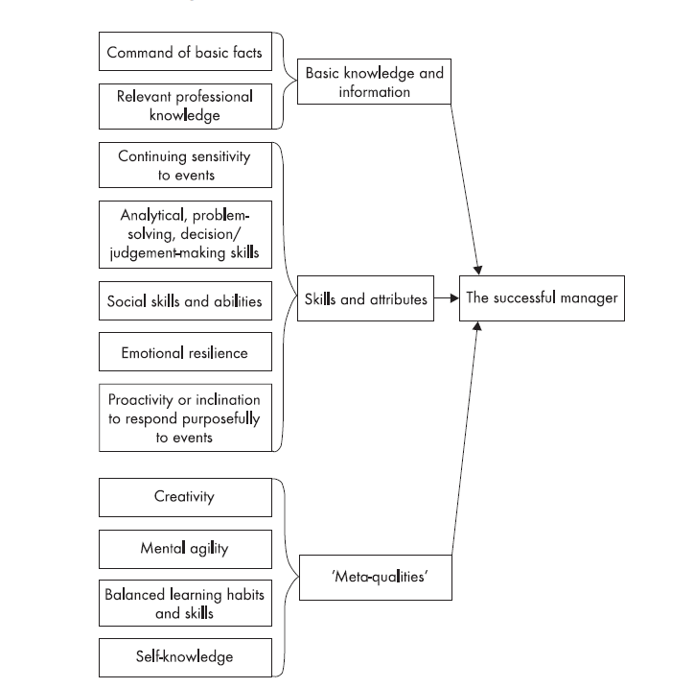

The Lancaster (Burgoyne) Model of Managerial Competencies
LEVEL 1
LEVEL 2
LEVEL 3

